Slide 1
Zygotic Genome Activation Occurs Shortly After Fertilization in Maize
Junyi Chen¹⁺, Nicholas Strieder²⁺, Nadia G. Krohn^{1,3}, Philipp Cyprys¹, Stefanie Sprunck¹, Julia C. Engelmann², and Thomas Dresselhaus^{1*}
¹Cell Biology and Plant Biochemistry, Biochemie-Zentrum Regensburg, University of Regensburg, 93053 Regensburg, Germany.
²Institute of Functional Genomics, University of Regensburg, 93053 Regensburg, Germany.
³Present address: Department of Agriculture, Regional Campus of Umuarama, State University of Maringa, 87507-190, Umuarama, PR, Brazil.
Group: Don’t Know What to Do!!!!
Team members: Edna, Fernando, Henrique

Slide 2
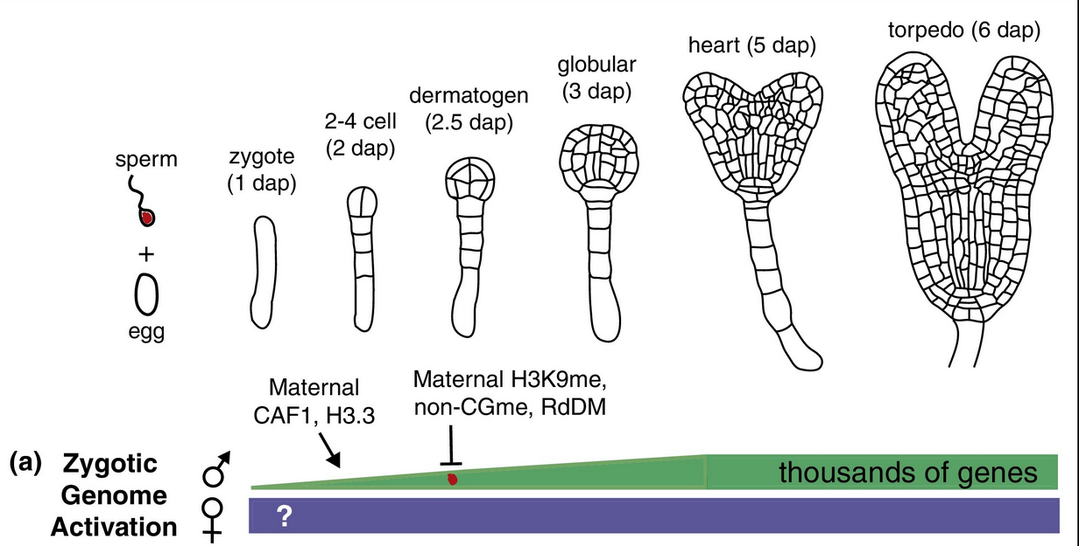
Background
ZGA: The onset of large-scale transcription that occurs after fertilization.
In animals: it occurs after a period of transcriptional quiescence that varies between spp.
In plants: timing may vary between spp & may or may not occur in a parent-of-origin dependent manner.
Paternal transcription: Increases during 1st few days after fertilization
Maternal transcription:?(hard to distinguish between maternal gametophytic and zygotic transcripts)
ZGA in early embryogenesis: Current opinion in plant biology
Notes:
Paternal transcription varies by gene. At the genome level, it increases during the first few days after fertilization, The question mark in the blue maternal transcript bar indicates that, as yet, there are no Experiments that have definitively assessed maternal transcription, due to the difficulties in distinguishing between maternal gametophytic and zygotic transcripts in the zygote

Slide 3
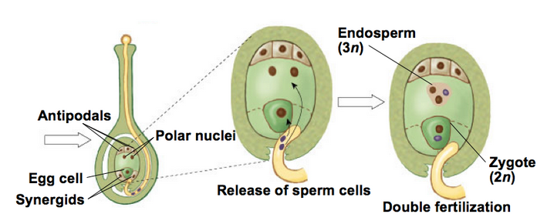
Why ZGA in plants
Life cycle of a flowering plant alternates between a 2n central cell & a haploid egg producing a 2n zygote & a 3n endosperm.
The zygote is the starting point for embryogenesis to develop a mature embryo
Challenges
Differentiation between maternal gametophytic (carryover from the egg/sperm) and zygotic transcripts origin (products of active transcription in the zygote).
2. Contamination of zygotic transcripts with maternal sporophytic transcripts during isolation of zygotic tissues
http://www.askiitians.com/biology/sexual-reproduction-in-flowering-plants
Notes:
However, there are difficulties in transcript profiling of early plant embryos

Slide 4
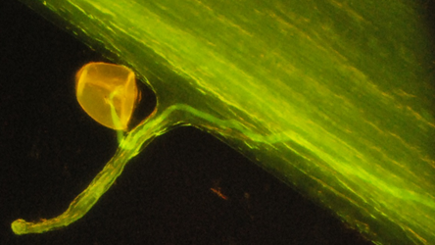
Study Methods
Manual isolation of male and female gametes, zygotes (12 and 24 HAF), and their daughter cells.
2. RNA-sequencing and transcriptomic dynamics after fertilization (3 replications/cell). Paired-end.
3. Mapping of the transcriptome of maize and rice to explore how the cell cycle, chromatin and auxin pathways are regulated after fertilization.
Summary:
Maize gametes and zygotes reveal highly
dynamic zygotic genome activation pattern
providing insights into early embryo development.
Notes:
They generated RNA-Seq data investigated the transcriptome dynamics after fertilization. They compared the transcriptomes of maize and (rice) gametes and explored how the cell cycle, chromatin, and auxin pathways are regulated. Finally, we identified transcription factor and receptor-like kinase genes associated with the various cell types and zygotic stages

Slide 5
WORKFLOW
Quality Control
Alignment reference Genome
Count of Reads
Differential Analysis
Processed data
Notes:
QC= remove poorly identified bases as well as any adapter sequences from reads
Count number of reads in each gene per sample
Differential analysis map to know which genes are differentially expressed using p values and FDR.
Get processed data for analysis

Slide 6
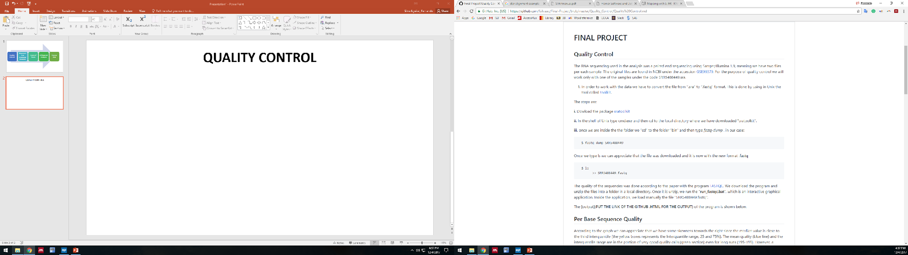
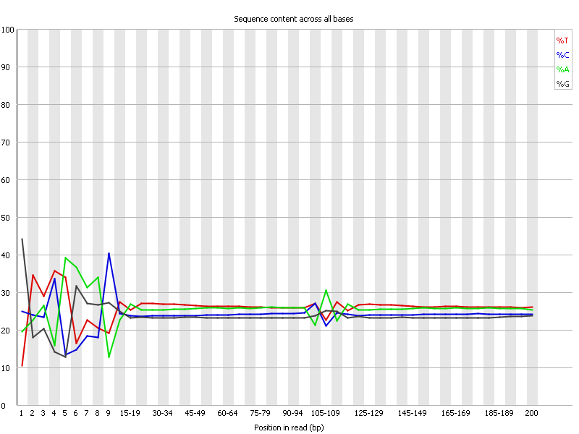
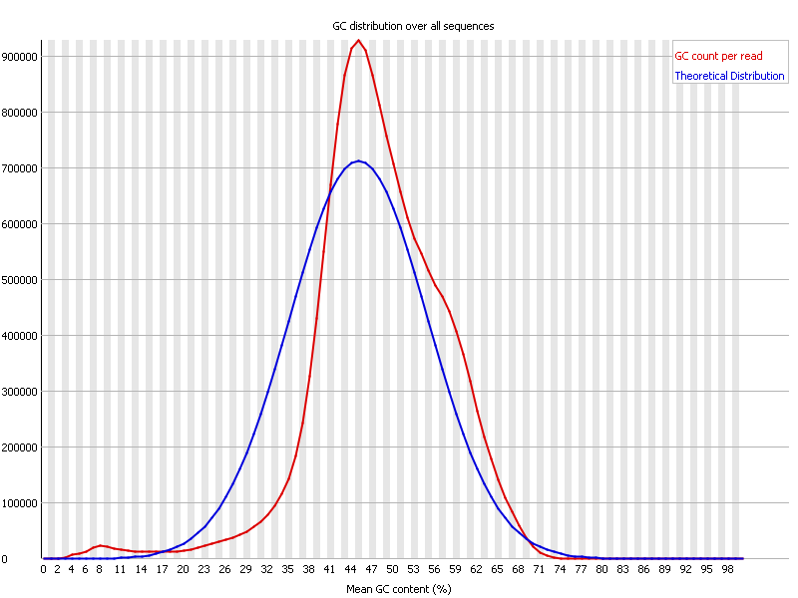
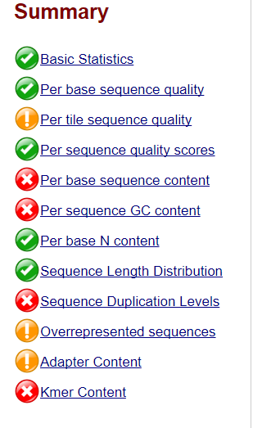
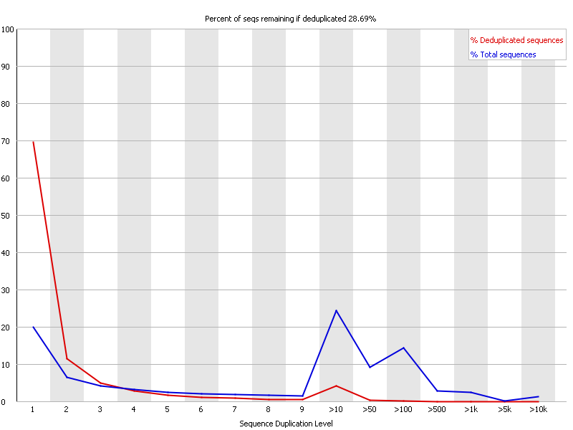
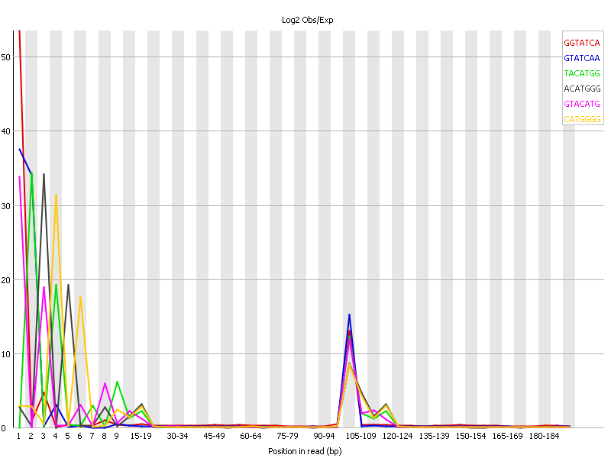
QUALITY CONTROL
Raw Data
Convert SRA to fastq. (sratoolkit for LINUX)
FASTQC
Per Base Sequence
Per Sequence GC Content
Expect Parallel lines
Sequence Duplication Levels
Kmer Content
Warnings

Slide 7
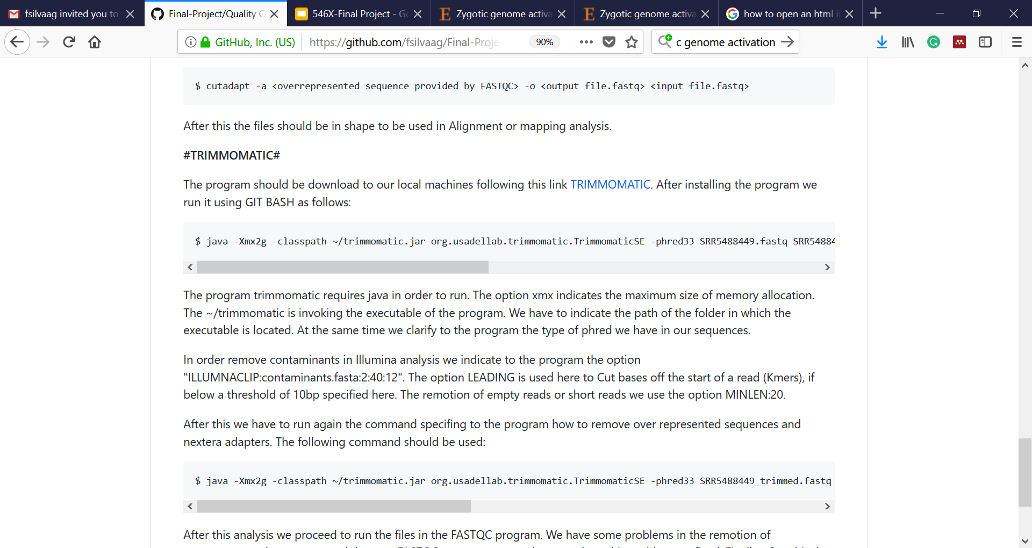
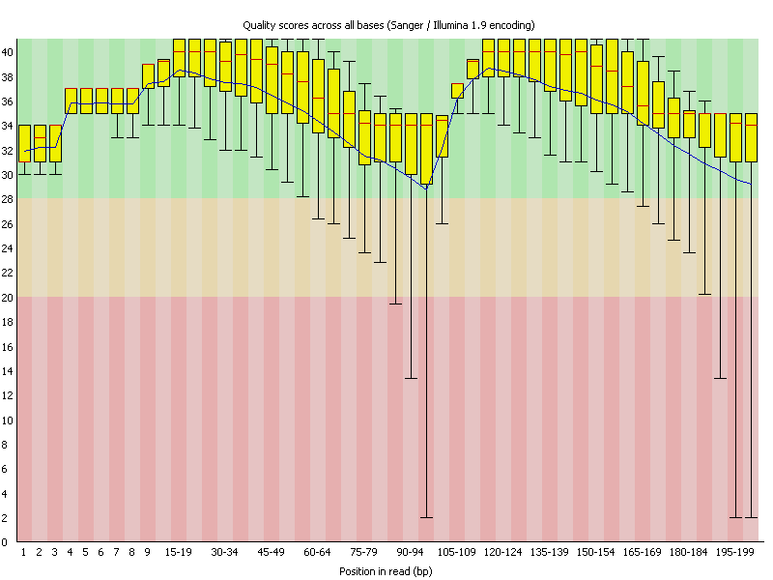
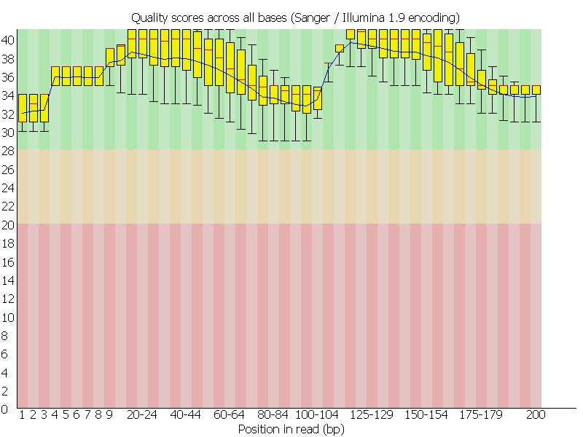
QUALITY CONTROL
Trimming was done with TRIMMOMATIC and/or CUTADAPT in LINUX.
Before Trimming
After Trimming

Slide 8
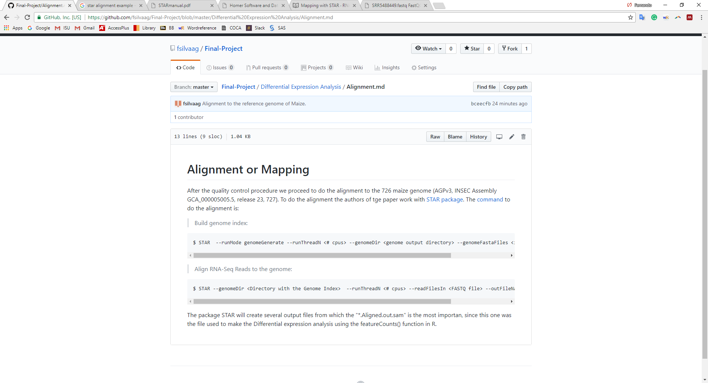
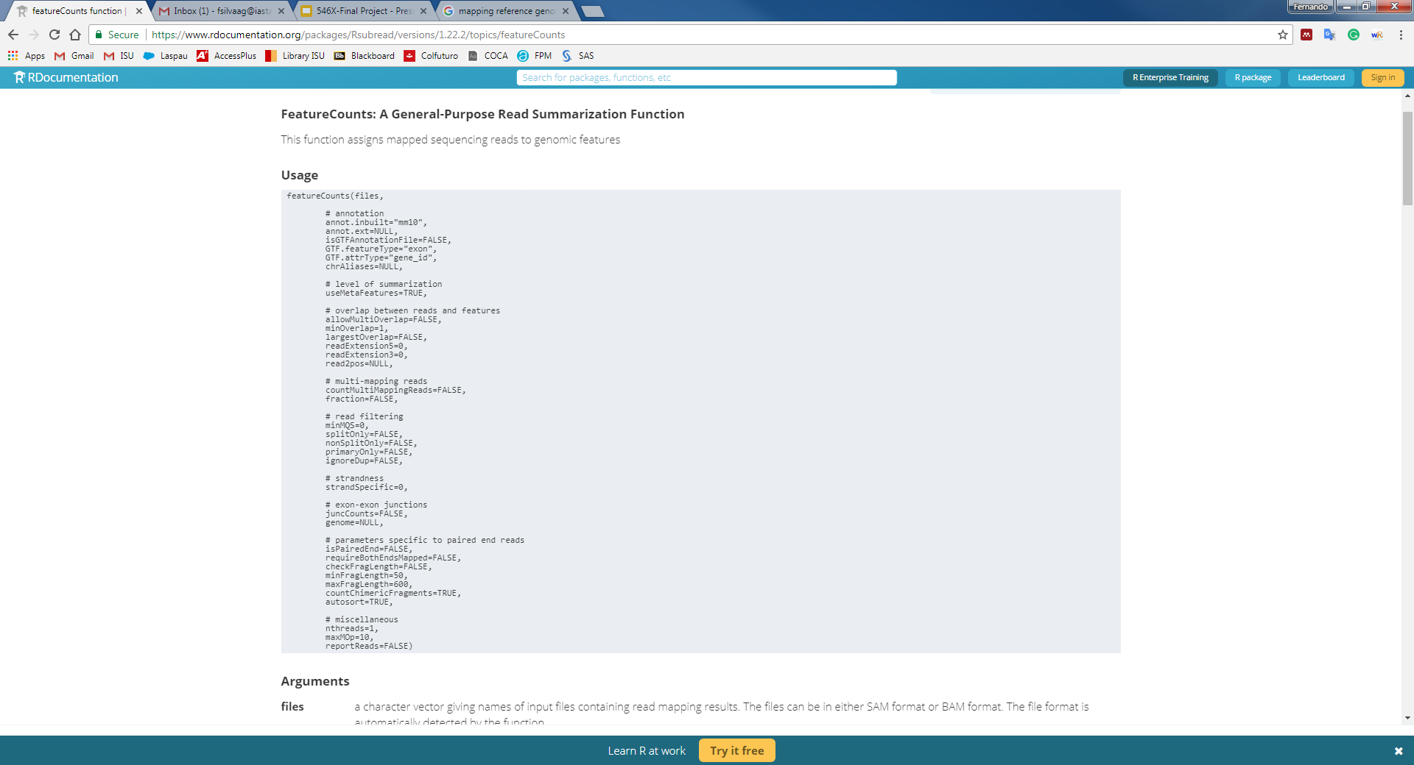
ALIGNMENT TO REFERENCE GENOME
Reference Genome was 726 maize genome (AGPv3, INSEC Assembly GCA_000005005.5, release 23, 727)
Use of the STAR package (LINUX):
SAM or BAM file
COUNT READS
Use of package Rsubreads function FeatureCounts
Liao et al., 2013. 1,2∗https://arxiv.org/pdf/1305.3347.pdf

Slide 9
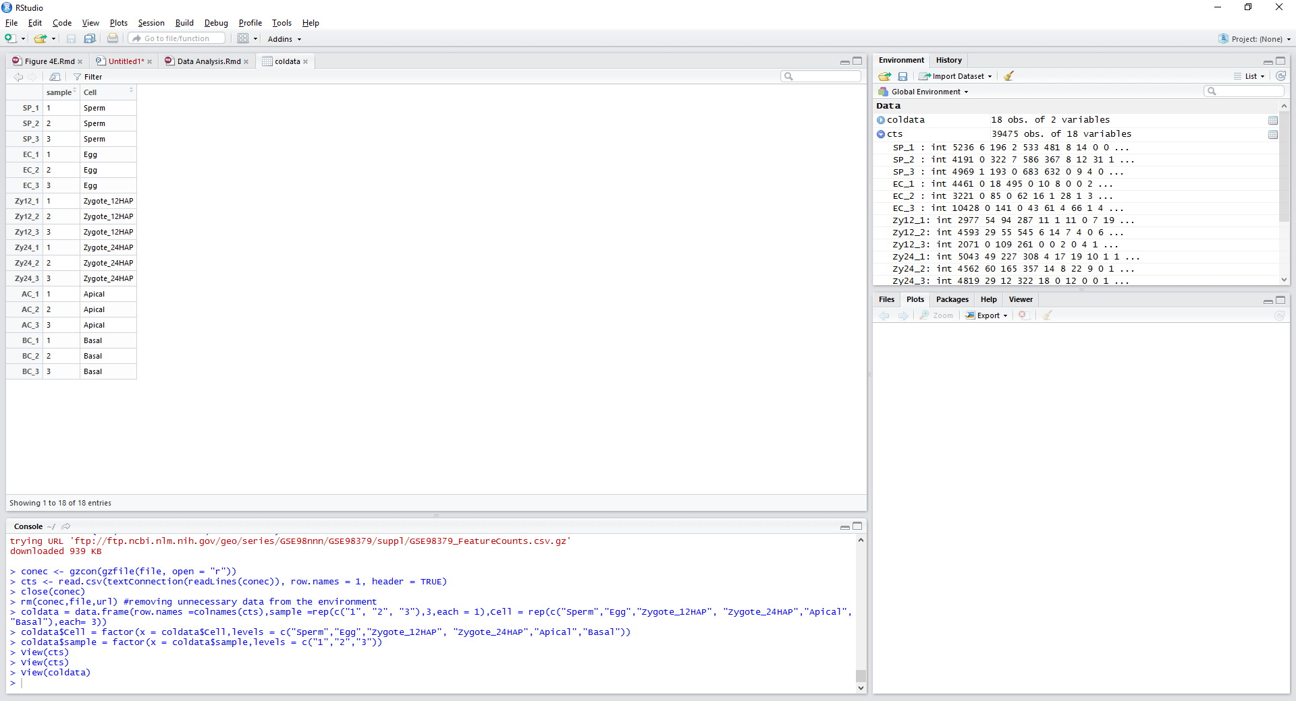
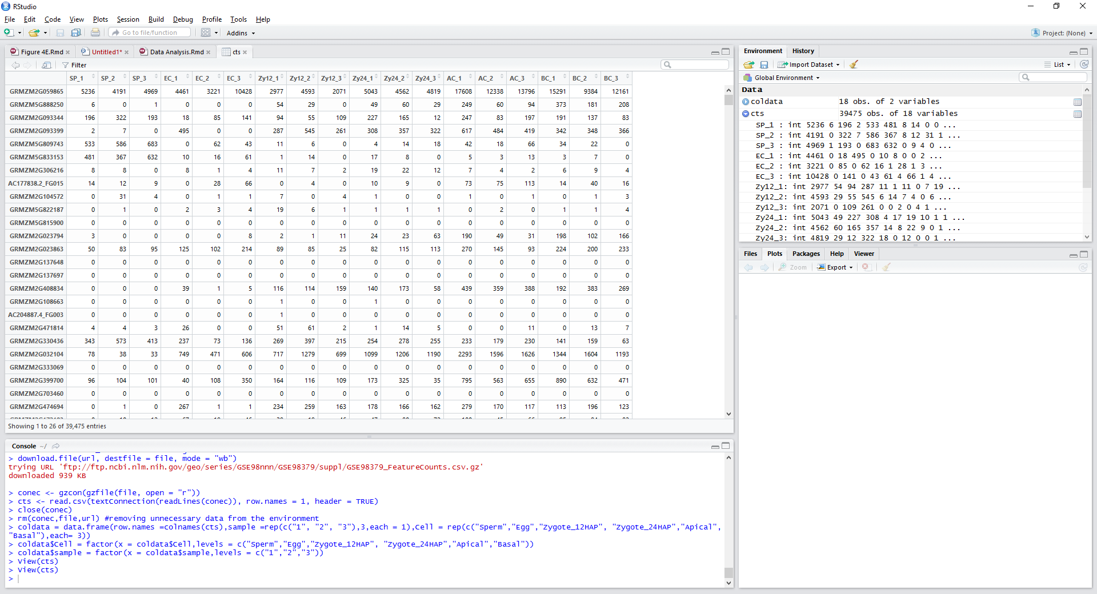
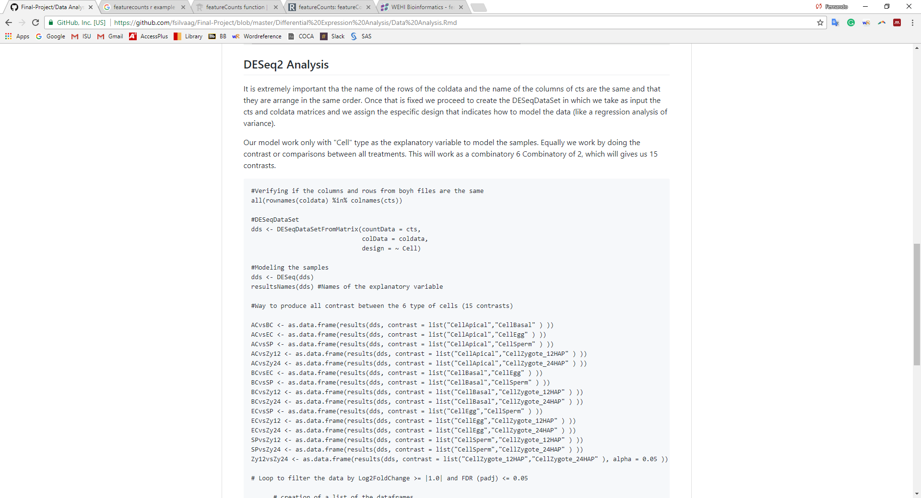
DIFFERENTIAL ANALYSIS
Once with the count ID of reads.
Package DESeq2.
Coldata file
cts file
Cell type and replication
Gene
DESeq2 ANALYSIS

Slide 10
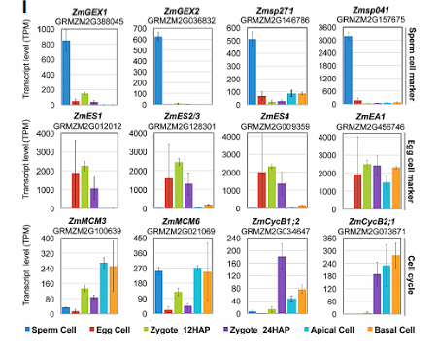
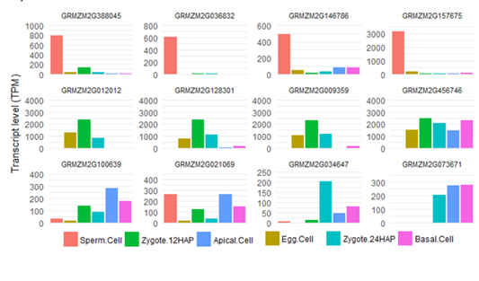

Results - Figure 1
Figure 1. Time course of zygote development and validation of RNA-Seq data. (I) Validation of RNA-Seq data with known genes, as indicated. Top row: Genes preferentially expressed in sperm cells; middle row: Genes highly expressed in egg cells and downregulated after fertilization; bottom row: Expression of cell cycle regulators. Transcript levels are shown as TPM (transcripts per million) values (means ± SD) of three biological replicates.

Slide 11
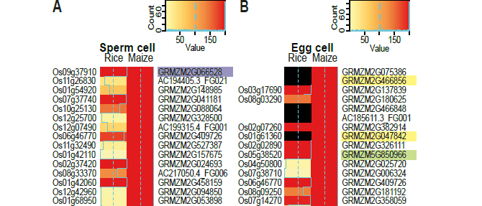
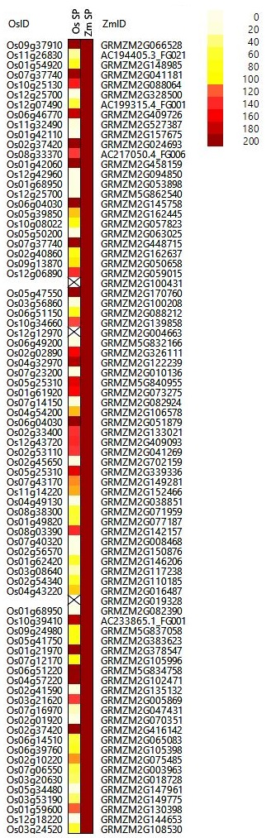
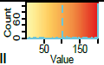
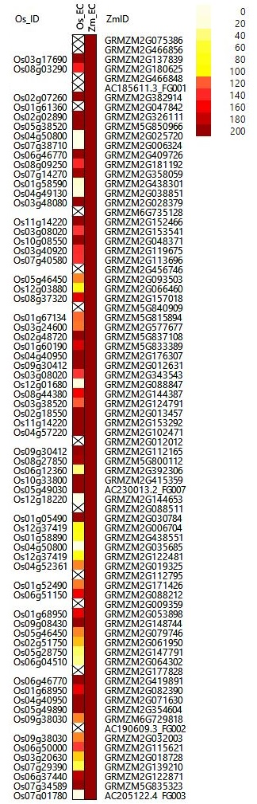
Results - Figure 2
Figure 2. Heatmap showing a comparison of the 80 most highly expressed genes in maize gametes and their predicted orthologs in the corresponding rice gametes. (A) TOP80 most highly expressed genes in maize sperm cells and (B) TOP80 genes in maize egg cells.

Slide 12
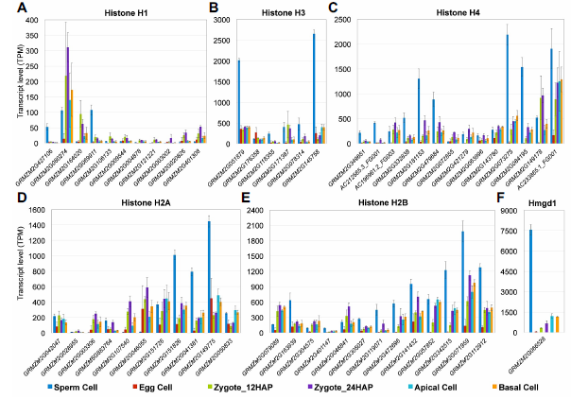
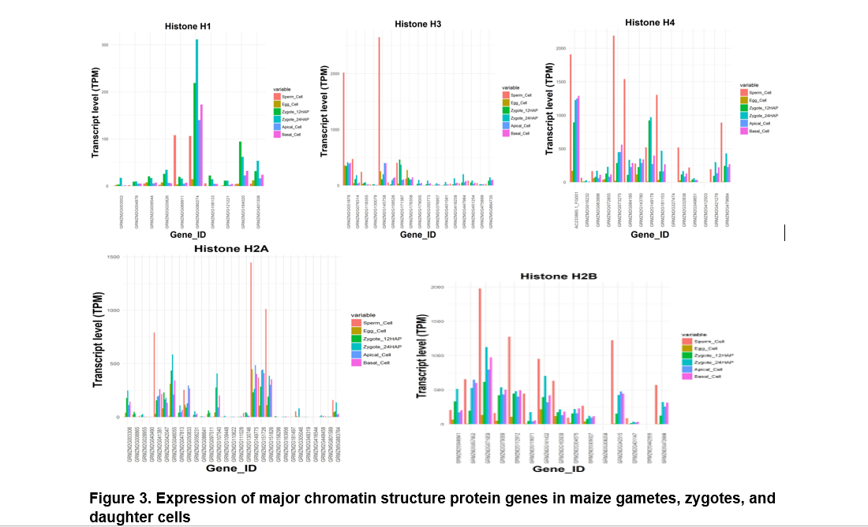
Results - Figure 3
Figure 3. Expression of major chromatin structure protein genes in maize gametes, zygotes, and daughter cells. (A) Histone H1, (B) histone H3, (C) histone H4, (D) histone H2A, (E) histone H2B, and (F) high mobility group protein Hmgd1. All significantly expressed genes of the various gene families are presented. Transcript levels in the cells indicated are given as TPM values (means ± SD).

Slide 13
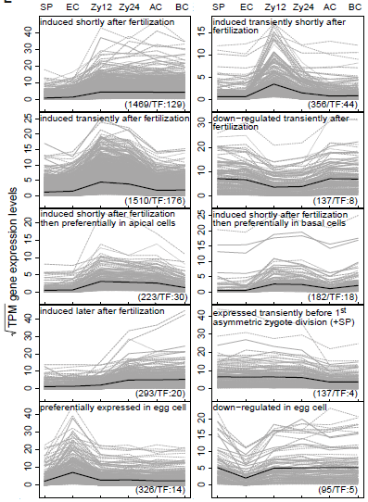
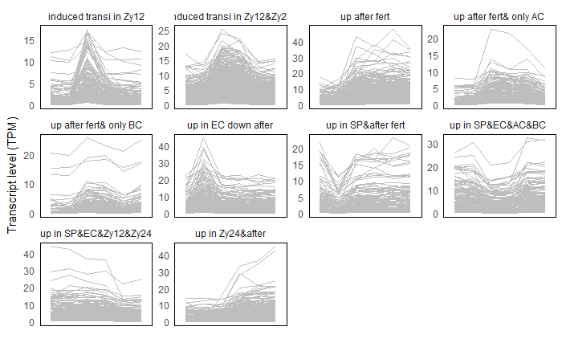
Results - Figure 4E
Figure 4. Gene expression dynamics in maize gametes, zygotes, and two-celled pro-embryo cells. (E) Selected gene expression profiles across the specific cell types analyzed. The Pearson correlation (>0.9) of square root transformed TPM values per gene and binary profile vectors were used to identify genes belonging to a specific profile. The total number of genes including TFs contained in each profile is shown at the bottom. The mean expression level of all genes per specific cell type is plotted in each profile (black line).

Slide 14
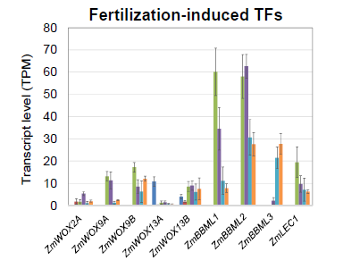
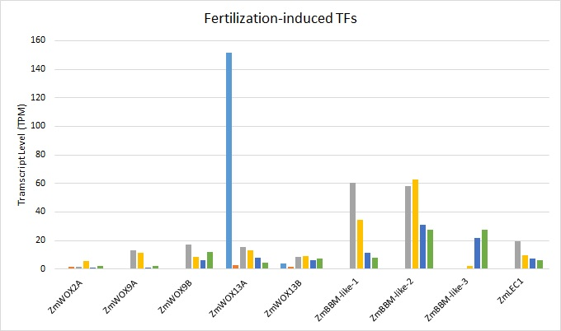
Results - Figure 5B
Figure 5B. Expression analysis of selected maize genes encoding homologs of Arabidopsis early embryogenesis-related TFs.

Slide 15
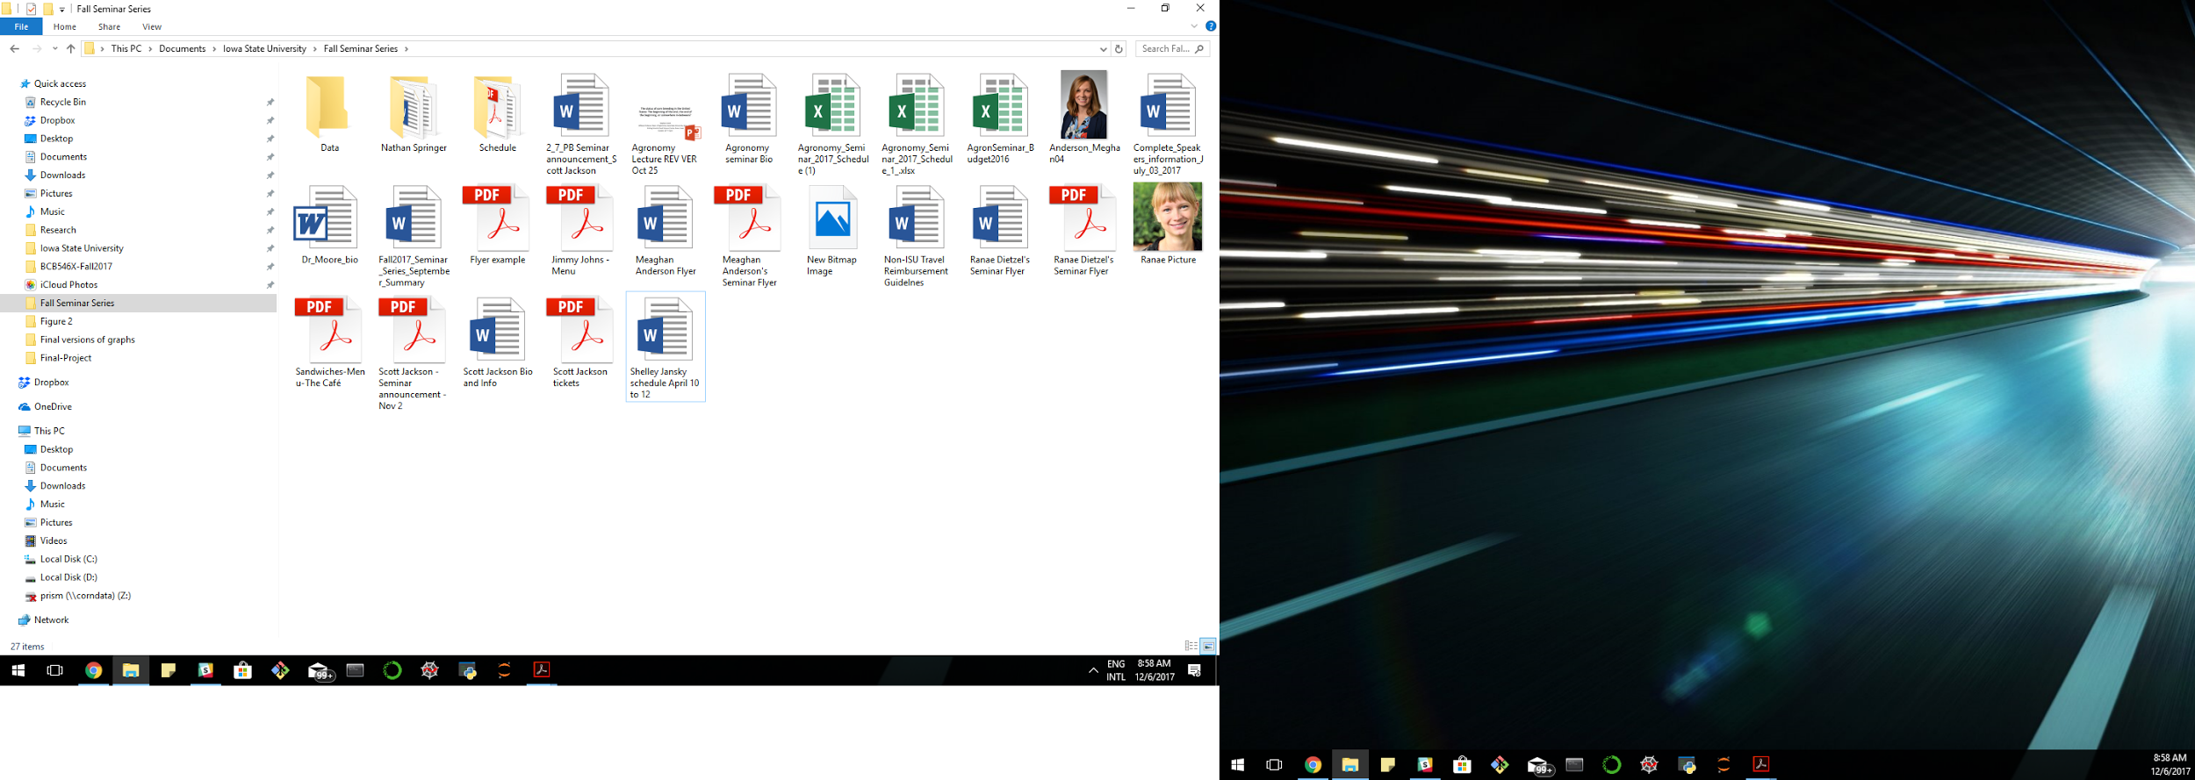
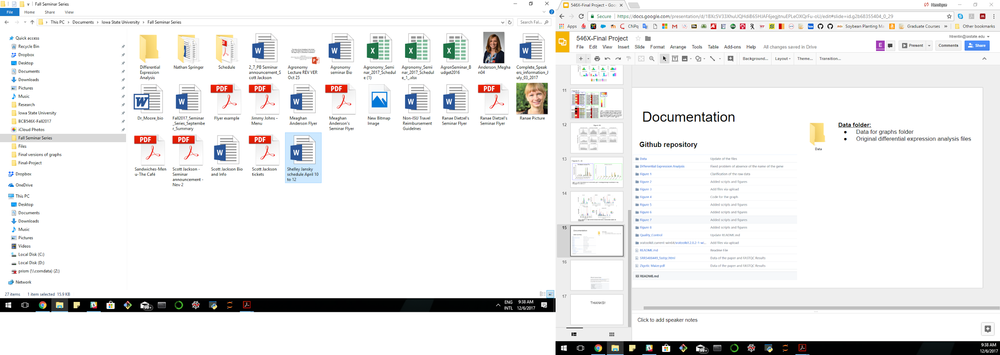
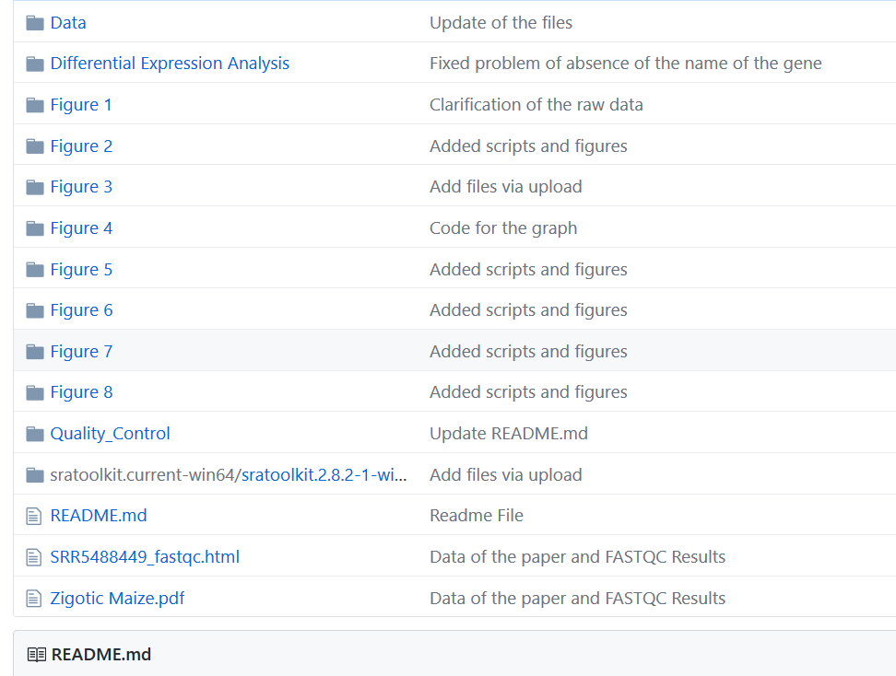
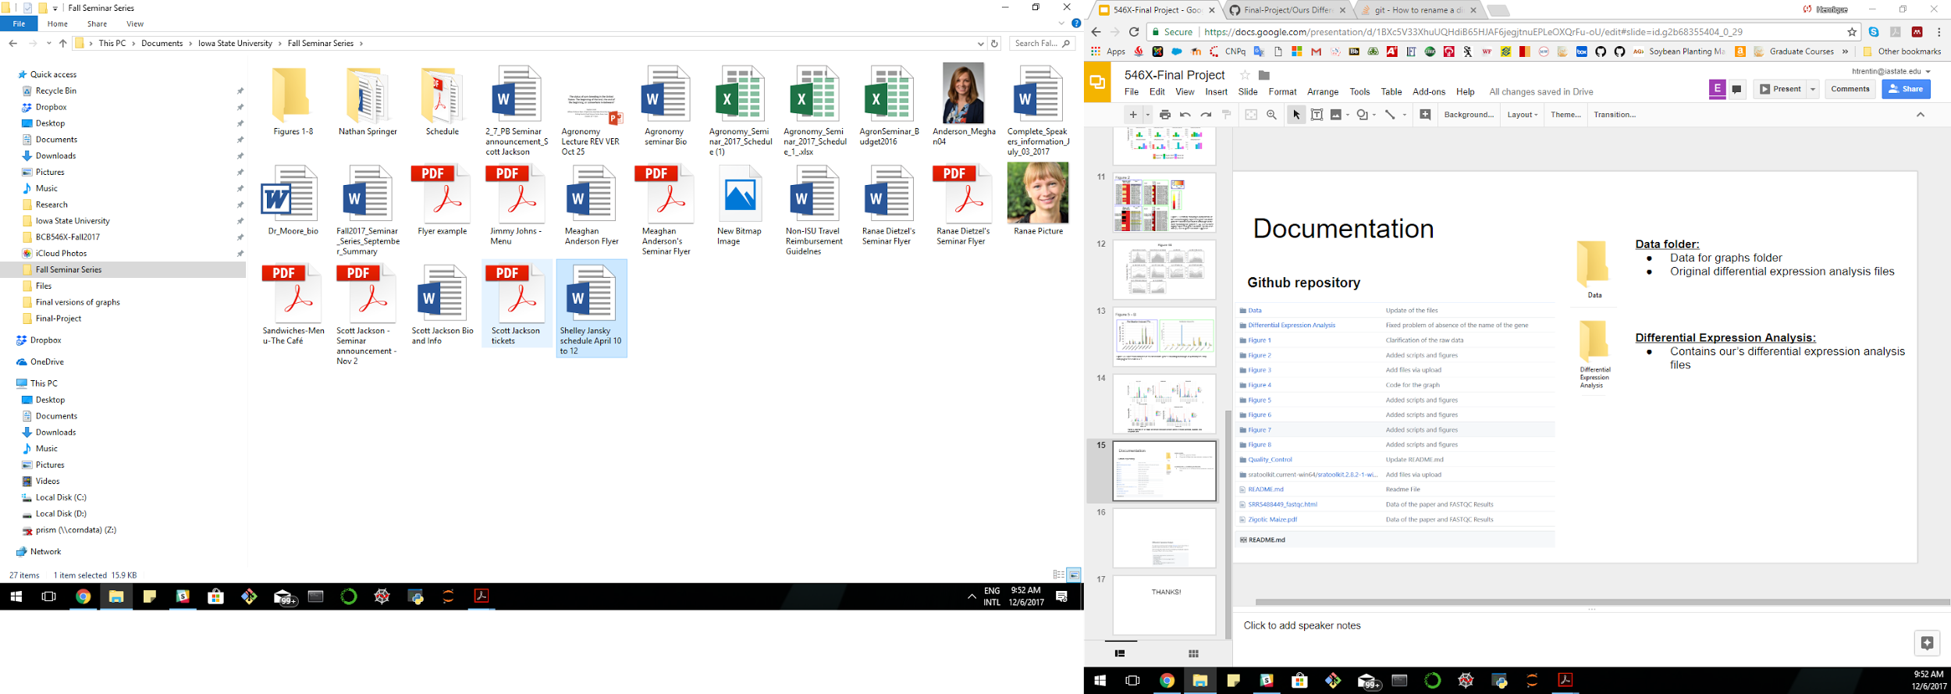
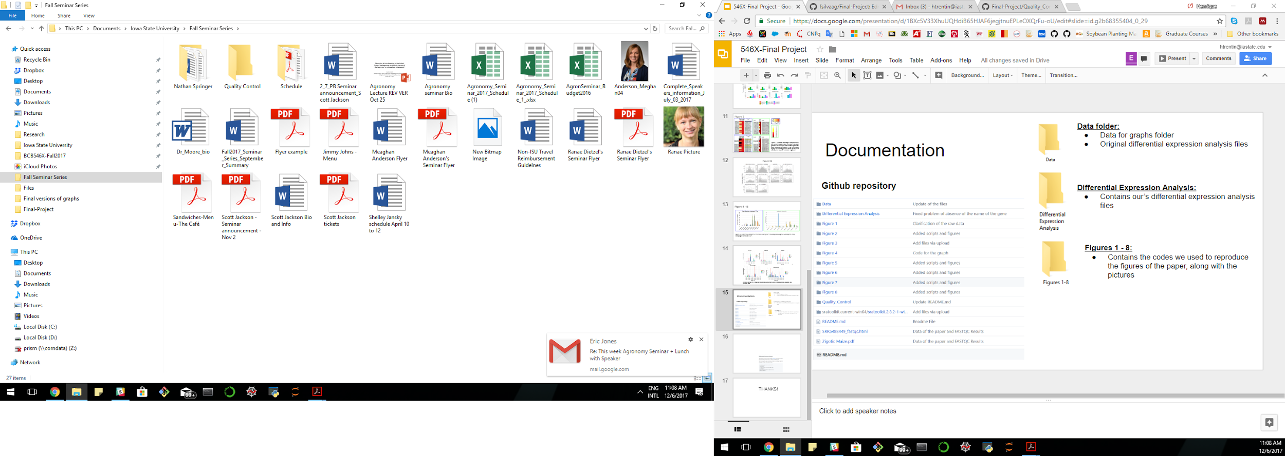
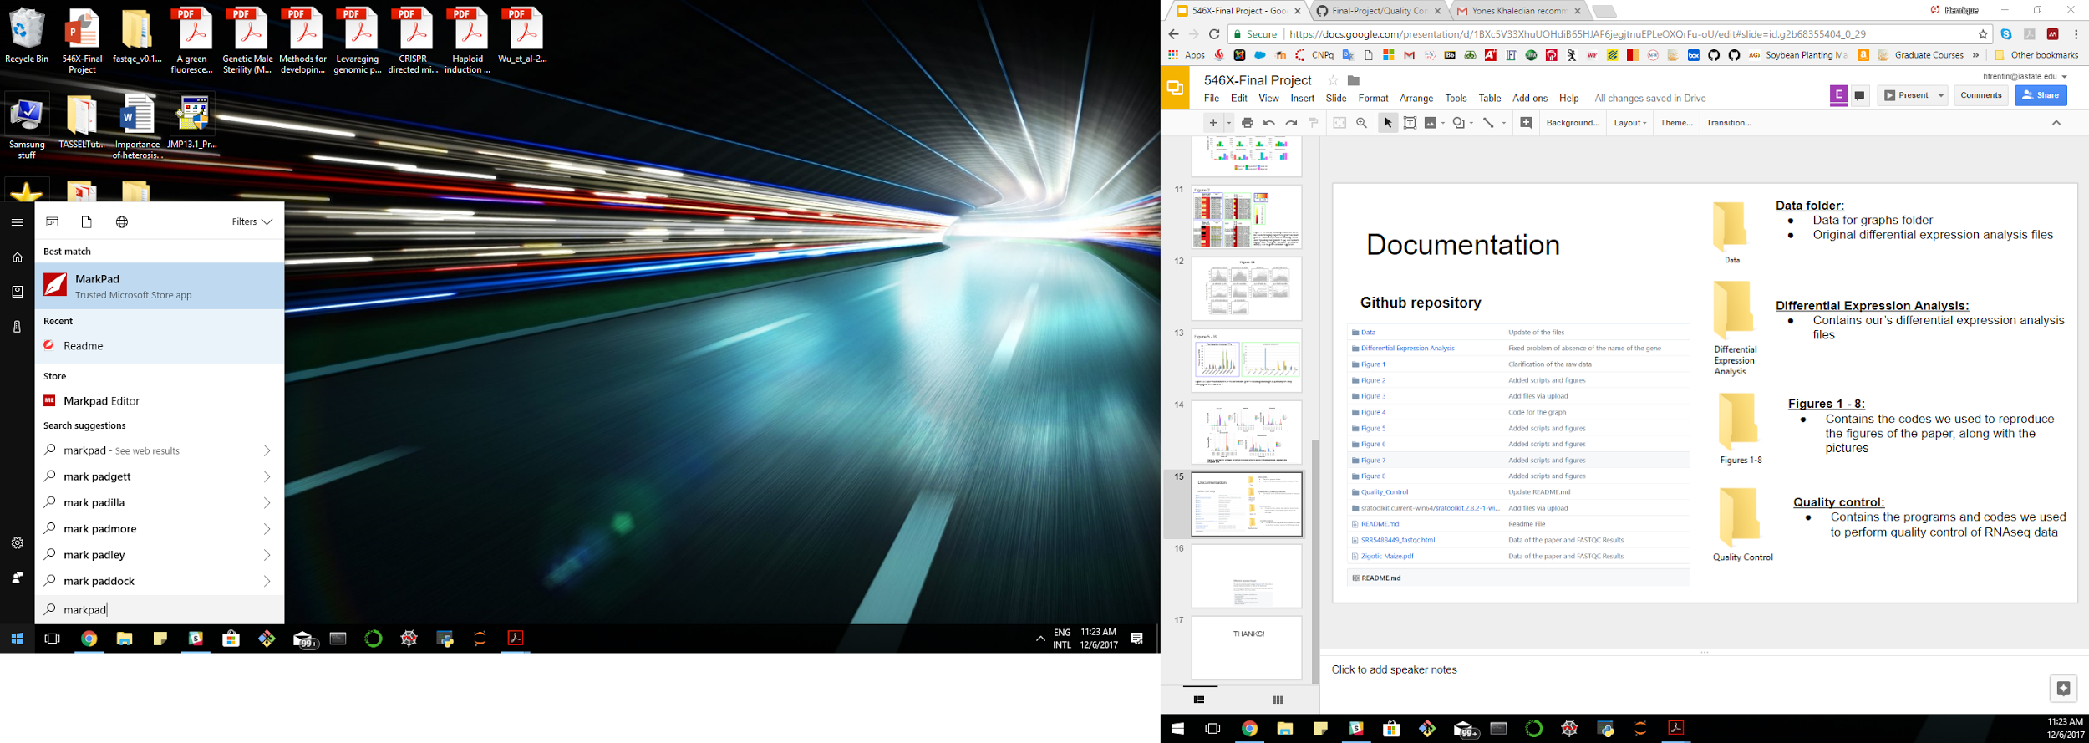
Documentation
Data folder:
Data for graphs folder
Original differential expression analysis files
Differential Expression Analysis:
Contains our’s differential expression analysis files
Github repository
Figures 1 - 8:
Contains the codes we used to reproduce the figures of the paper, along with the pictures
Quality control:
Contains the programs and codes we used to perform quality control of RNAseq data
Readme.md:
Readme.md files that explain the content of each folder

Slide 16
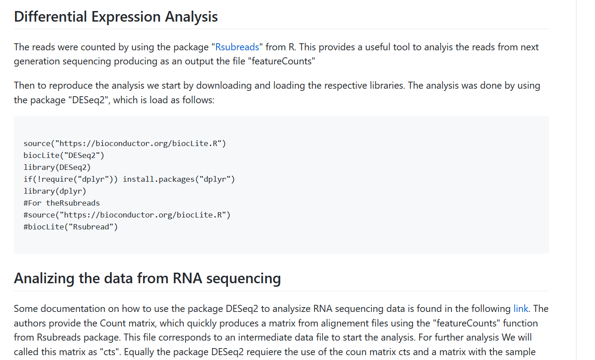
Documentation - Example
DataAnalysis.Rmd
Intro/Explanation
Code
Intro/Explanation

Slide 17
Thank you!
Questions?

